Slide 1
Automated, Electronic Alerts for AKI
A Randomized, Controlled Trial
F. Perry Wilson, MD MSCE : @nephrolalia
NephJC Live Journal Club
Philadelphia, PA
11/15/14
clinicaltrials.gov NCT01862419

Slide 2
Disclosures
Co-Inventor of patent relating to the real-time detection of AKI

Slide 3
Background
AKI, especially mild AKI, frequently goes unrecognized in the hospital setting
Earlier recognition may afford the opportunity to take corrective action
Wilson et al. Clin Nephrol 2013

Slide 4
Trial Diagram
2400 adults > 18 years old admitted to the Hospital of the University of Pennsylvania.
ACUTE KIDNEY INJURY
KDIGO Stage 1 AKI
0.3 mg/dl in 48 hours
50% in 7 days
Exclusion Criteria
Medical Ward
Surgical Ward
Medical ICU
Surgical ICU
Randomize 1:1
Randomize 1:1
Randomize 1:1
Randomize 1:1
Alert
No Alert
Alert
No Alert
Alert
No Alert
Alert
No Alert

Slide 5
Minimal Exclusion Criteria
-Initial creatinine > 4.0mg/dl
-Prior admission in which patient was randomized
-Admission to hospice service
-Admission to observation status

Slide 6
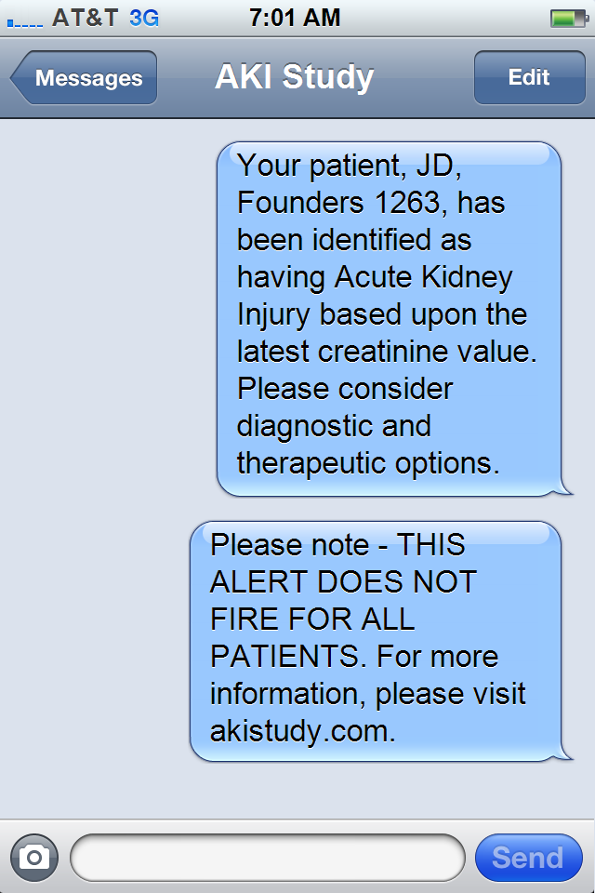
The Alert - Practical
(Alerts are sent to the "covering provider“ and the unit-based pharmacist)

Slide 7
Primary Outcome
We have developed a rank-based outcome score that captures the severity of AKI by combining continuous and categorical outcomes
Patients are ranked according to the relative change in creatinine from the alert (greater change being a worse outcome)
All dialyzed patients are ranked as worse than the highest relative change in creatinine in non-dialyzed patients.
All patients who die are ranked worse than those who are dialyzed but do not die
Wilson et al. Clinical Trials 2014.

Slide 8
Pre-specified Secondary Outcomes
Mortality Endpoints
7-day mortality
Inpatient mortality
30-day mortality
Dialysis Endpoints
7-day dialysis
Inpatient dialysis
Discharge on dialysis
Process endpoints
Contrast administration
Fluid administration
Aminoglycoside administration
NSAID administration
ACE-Inhibitor / ARB administration
Renal consult
Urinalysis order
Renal ultrasound order
Subclavian catheter placement
Renal Failure Endpoints
Progression to stage 2 AKI
Progression to stage 3 AKI
Hospitalization Endpoints
Hospital-free days post AKI
ICU-free days post AKI
Readmission rate and Cost Endpoints
30-day readmission rate
Cost of hospitalization
Provider Awareness endpoints
Chart documentation of AKI

Slide 9
Ethical Considerations – Informed Consent
We believed this study could not be feasibly performed if informed consent was obtained from each participant
A participant randomized to the control group would have to be asked not to inform their clinician about the presence of AKI – threatening the therapeutic relationship
Consenting all hospitalized patients would be onerous and expose a large number of individuals to the risk of potential loss of confidentiality

Slide 10
Baseline Characteristics, Quality of Randomization
Characteristic | Alert (n=1197) | Usual Care (n=1189) | P-Value
Age | 60.1 (16.5) | 60.6 (16.1) | 0.54
Male | 670 (56.2) | 655 (55.4) | 0.70
Black | 324 (27.0) | 323 (27.1) | 0.95
Surgical | 516 (43.0) | 497 (41.7) | 0.53
Cerebrovascular Disease | 142 (11.8) | 126 (10.6) | 0.32
CHF | 386 (32.2) | 373 (31.3) | 0.64
Diabetes | 352 (29.3) | 370 (31.0) | 0.36
Liver disease | 164 (13.7) | 181 (15.2) | 0.29
Chronic Kidney Disease | 323 (26.9) | 314 (26.3) | 0.74
Malignancy | 335 (27.9) | 309 (25.9) | 0.27
Metastasis | 103 (8.6) | 111 (9.3) | 0.54
Baseline Creatinine, mg/dl | 0.91 (0.60 - 1.37) | 0.90 (0.56 - 1.36) | 0.30
Alert Creatinine, mg/dl | 1.38 (1.01 - 1.90) | 1.37 (0.95 - 1.88) | 0.18
In ICU at Alert | 365 (30.4) | 357 (29.9) | 0.81
Time from Admission to AKI | 2.41 (1.18 - 5.71) | 2.65 (1.15 - 5.75) | 0.24

Slide 11
Primary Outcome: 7 Days
Components | Alert (n=1197) | Usual Care (n=1189) | P-Value | Composite P-Value
Max rel change creat (IQR) | 0 (0 – 18%) | 0.6 (0 – 17.5%) | 0.88 | 0.12
Dialysis, % | 7.2% | 5.9% | 0.18
Death, % | 5.9% | 5.1% | 0.40

Slide 12
Primary Outcome: 14 Days
Components | Alert (n=1197) | Usual Care (n=1189) | P-Value | Composite P-Value
Max rel change creat (IQR) | 0.9 (0 – 20.6%) | 1.4 (0 – 20.2%) | 0.87 | 0.10
Dialysis, % | 8.2% | 6.6% | 0.15
Death, % | 7.7% | 7.1% | 0.57

Slide 13
Primary Outcome: 30 Days
Components | Alert (n=1197) | Usual Care (n=1189) | P-Value | Composite P-Value
Max rel change creat (IQR) | 1.3 (0 – 22%) | 2.1 (0 – 22%) | 0.78 | 0.17
Dialysis, % | 8.7% | 7.4% | 0.25
Death, % | 8.8% | 9.0% | 0.90

Slide 14
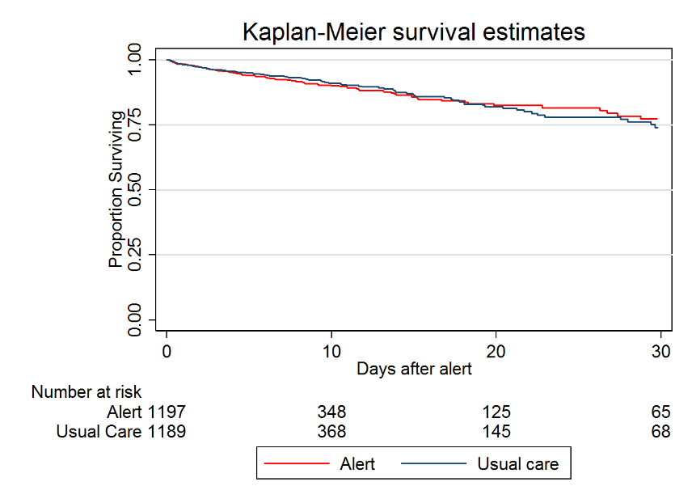
Secondary Outcomes: Mortality
Outcome | Alert (n=1197) | Usual Care (n=1189) | P-value
7-day mortality | 5.9% | 5.1% | 0.40
14-day mortality | 7.7% | 7.1% | 0.57
30-day mortality | 8.8% | 8.9% | 0.90
Inpatient mortality | 9.8% | 9.4% | 0.72
P=0.50
*Censored at discharge

Slide 15
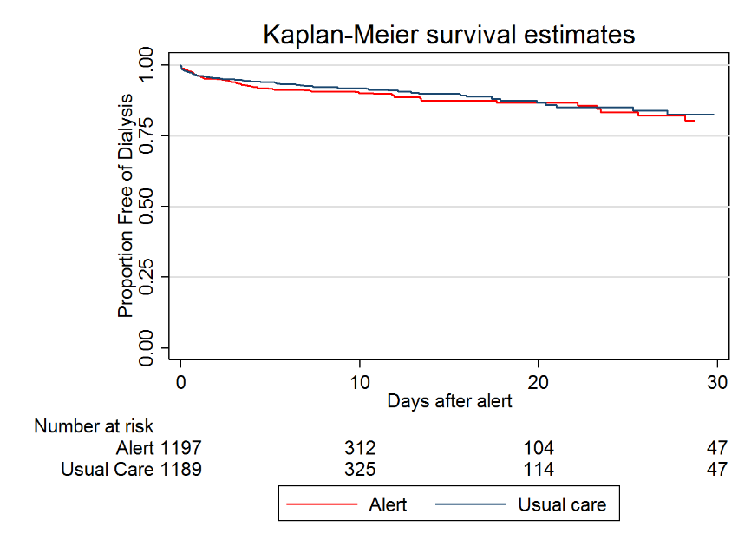
Secondary Outcomes: Dialysis
Outcome | Alert (n=1197) | Usual Care (n=1189) | P-value
7-day dialysis | 7.2% | 5.9% | 0.18
14-day dialysis | 8.1% | 6.6% | 0.15
30-day dialysis | 8.7% | 7.4% | 0.25%
Inpatient dialysis | 8.7% | 7.7% | 0.36
P=0.31
*Censored at death or dc

Slide 16
Conclusions
A broadly implemented AKI alert system failed to improve clinical outcomes or significantly affect process outcomes in a large, urban tertiary care center
Explanations
Doctors too good
Alert not “strong” enough
Alert not targeted appropriately
“Obvious” AKI
“False-Positive” AKI
Contamination across intervention groups

Slide 17
Future Directions
More directed studies with specific interventions
Even promoting documentation could be a reasonable proof-of-concept
Other centers?
Identification of high-risk individuals early
Implementation of more sophisticated algorithms

Slide 18
Thanks
Renal:
-Iram Aqeel
-Amar Bansal
-Harv Feldman (mentor)
-Eugene Gitelman
-Peter Reese
-Ubaid Ullah
Pulmonary / Critical Care:
-Barry Fuchs
-Michael Shashaty
Informatics:
-Yuliya Borovskiy
-Richard Urbani

Slide 19
Thanks
Penn Center for Healthcare Improvement and Patient Safety (CHIPS)
NIDDK K23-DK097201

Slide 20
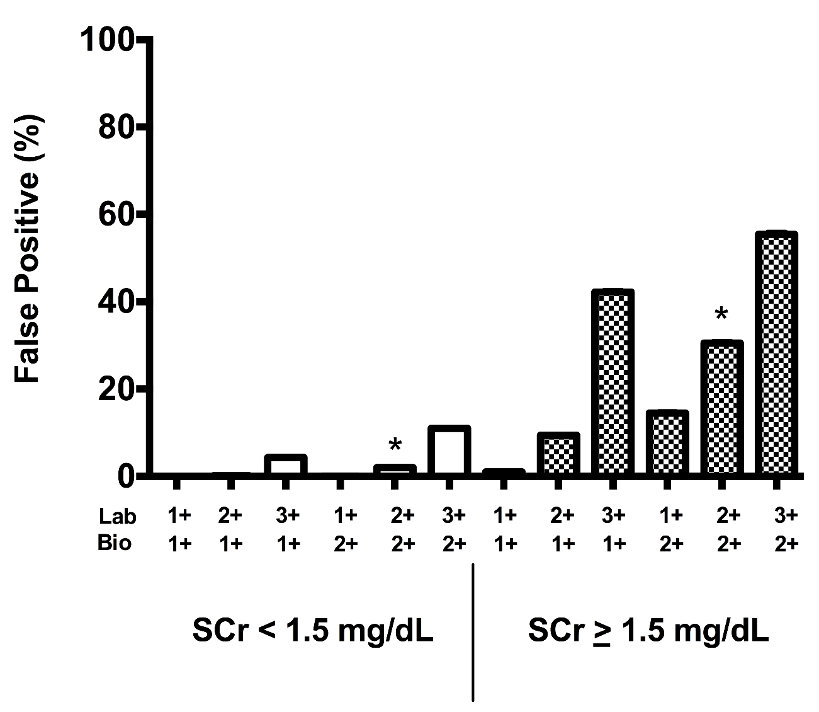
Variability in Creatinine Measurement May Lead to False-Positive AKI Diagnosis
100 simulations of a 2400 patient cohort, examining different levels of biological and laboratory variation of creatinine and overall false positive rates of AKI.

Slide 21
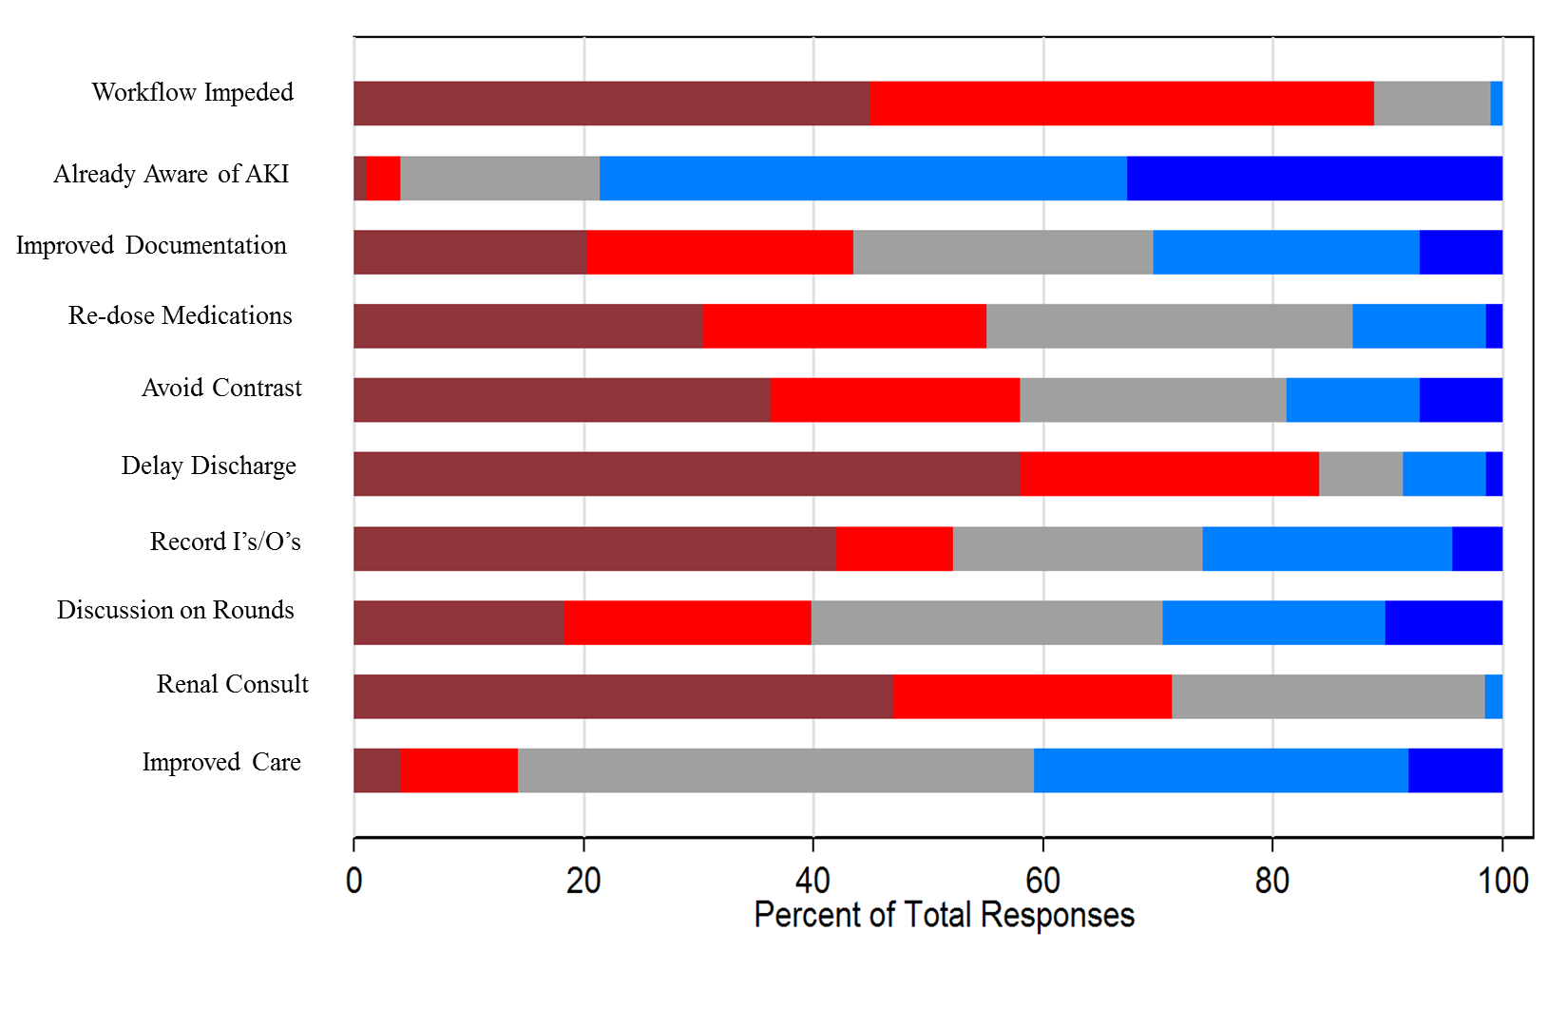
Provider Acceptance (n=97)
69% of providers stated they would like to continue receiving alerts after the study ended.

Slide 22
Acceptance over Time
P=0.02

Slide 23
Secondary Outcomes: KDIGO Stage Achieved
Stage Achieved | Alert (n=1197) | Group 2 (n=1189) | P-Value
Stage 1 | 77% | 78% | 0.81
Stage 2 | 11.8% | 11.4%
Stage 3 | 11.2% | 10.5%

Slide 24
Secondary Outcomes: Chart Documentation

Slide 25
Secondary Outcomes: Contrast
P=0.75

Slide 26
Secondary Outcomes: Fluids
P=0.80

Slide 27
Pre-specified subgroups: Surgical (n=1013)
Components | Alert (n=516) | Usual Care (n=497) | P-Value | Composite P-Value
Max rel change creat (IQR) | 0 (0 – 14.8%) | 0 (0 – 14.9%) | 0.94 | 0.38
Dialysis, % | 7.2% | 5.8% | 0.39
Death, % | 5.0% | 3.8% | 0.34

Slide 28
Pre-specified subgroups: ICU (n=722)
Components | Alert (n=365) | Usual Care (n=357) | P-Value | Composite P-Value
Max rel change creat (IQR) | 7.8 (0 – 32.4%) | 8.2 (0 – 36%) | 0.68 | 0.31
Dialysis, % | 13.2% | 11.5% | 0.50
Death, % | 13.2% | 12.9% | 0.92

Slide 29
Pre-specified subgroups: Low baseline (<1) n=1340
Components | Alert (n=671) | Usual Care (n=669) | P-Value | Composite P-Value
Max rel change creat (IQR) | 0 (0 – 13.5%) | 0 (0 – 14.1%) | 0.32 | 0.10
Dialysis, % | 1.8% | 1.8% | 0.99
Death, % | 5.1% | 3.3% | 0.10

Slide 30
Pre-specified subgroups: Low baseline (<=0.6) n=616
Components | Alert (n=287) | Usual Care (n=329) | P-Value | Composite P-Value
Max rel change creat (IQR) | 0 (0 – 15%) | 0 (0 – 13.9%) | 0.14 | 0.51
Dialysis, % | 1.7% | 1.5% | 0.83
Death, % | 3.1% | 2.7% | 0.77

Slide 31
Pre-specified subgroups: Black Patients (n=647)
Components | Alert (n=324) | Usual Care (n=323) | P-Value | Composite P-Value
Max rel change creat (IQR) | 0 (0 – 15%) | 0 (0 – 15%) | 0.96 | 0.47
Dialysis, % | 7.7% | 4.3% | 0.07
Death, % | 3.1% | 5.3% | 0.17

Slide 32
Pre-specified subgroups: Women (n=1051)
Components | Alert (n=523) | Usual Care (n=528) | P-Value | Composite P-Value
Max rel change creat (IQR) | 0 (0 – 16%) | 0 (0 – 16%) | 0.53 | 0.24
Dialysis, % | 6.1% | 4.9% | 0.40
Death, % | 6.1% | 4.5% | 0.26

Slide 33
Pre-specified subgroups: Age >=65 (n=1015)
Components | Alert (n=514) | Usual Care (n=501) | P-Value | Composite P-Value
Max rel change creat (IQR) | 1.5 (0 – 18.5%) | 0.6 (0 – 18.3%) | 0.69 | 0.28
Dialysis, % | 7.2% | 6.0% | 0.44
Death, % | 8.0% | 7.8% | 0.91

Slide 34
Wireless Communication Transfer Protocol (n=1352)
Components | Alert (n=672) | Usual Care (n=680) | P-Value | Composite P-Value
Max rel change creat (IQR) | 0 (0 – 17%) | 0 (0 – 19.6 %) | 0.86 | 0.27
Dialysis, % | 7.1% | 5.9% | 0.35
Death, % | 6.7% | 5.7% | 0.46

Slide 35
Secondary Outcomes: Aminoglycoside Usage
P=0.10

Slide 36
Secondary Outcomes: NSAID
P=0.97

Slide 37
Secondary Outcomes: ACE/ARB
P=0.13

